Slide 1

Operating Systems
Unit 4 – Memory Management Strategies
Basic Concepts

Slide 2
Basic Hardware
Main Memory and Registers, only CPU can directly access.
There are machine instructions that take memory addresses as arguments, but none that take disk addresses.
Any instructions in execution, and any data being used by the instructions, must be in one of these direct-access storage devices.
If the data are not in memory, they must be moved there before the CPU can operate on them.

Slide 3
Basic Hardware
Registers that are built into the CPU are generally accessible within one cycle of the CPU clock.
In main memory, which is accessed via a transaction on the memory bus. Completing a memory access may take many cycles of the CPU clock.
In such cases, the processor normally needs to stall, since it does not have the data required to complete the instruction that it is executing.
This situation is intolerable because of the frequency of memory accesses. The remedy is to add fast memory between the CPU and main memory, typically on the CPU chip for fast access.
Cache

Slide 4
Basic Hardware
Speed of access memory not only primary concern but also ensure correct operation.
For proper system operation we must protect the operating system from access by user processes.
On multiuser systems, we must additionally protect user processes from one another
Ensure that each process has a separate memory space. Separate per-process memory space protects the processes from each other and multiple processes loaded in memory for concurrent execution.
To separate memory spaces, we need the ability to determine the range of legal addresses that the process may access and to ensure that the process can access only these legal addresses.
We can provide this protection by using two registers, usually a base and a limit.

Slide 5
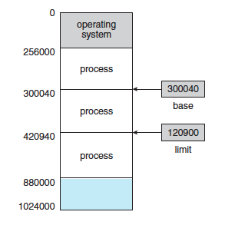
Basic Hardware
The base register holds the smallest legal physical memory address;
the limit register specifies the size of the range.
if the base register holds 300040 and the limit register is 120900, then the program can legally access all addresses from 300040 through 420939.
Protection of memory space is accomplished by having the CPU hardware compare every address generated in user mode with the registers.
Any attempt by a program executing in user mode to access operating-system memory or other users’ memory results in a trap to the operating system, which treats the attempt as a fatal error

Slide 6
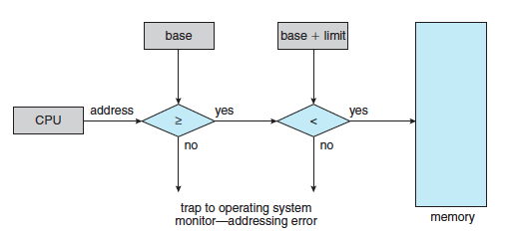
Basic Hardware

Slide 7
Basic Hardware
This scheme prevents a user program from (accidentally or deliberately) modifying the code or data structures of either the operating system or other users.
The base and limit registers can be loaded only by the operating system, which uses a special privileged instruction.
Since privileged instructions can be executed only in kernel mode, and since only the operating system executes in kernel mode, only the operating system can load the base and limit registers.
This scheme allows the operating system to change the value of the registers but prevents user programs from changing the registers’ contents

Slide 8
THANK YOU

